Slide 1
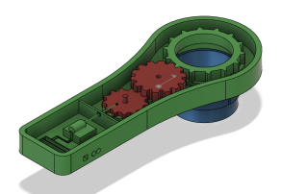
DESIGN AND FABRICATION OF NUT & BOLT FASTNER
PROJECT MEMBERS:
R KARUNA KARAN | 811722114022
G LAYA ANTO | 811722114023
MOHAN B | 811722114028
PRAJEN B | 811722114030
GUIDED BY:
Mr A.GODWIN ANTONY
ASSISTANT PROFESSOER
MECHANICAL ENGINEERING
K.Ramakrishnan College of Technology

Slide 2
Content
CONTENT | SLIDE NUMBER
ABSTRACT | 3
OBJECTIVE | 4
PROBLEM IDENTIFICATION | 5
METHODOLOGY | 6
BUDGET | 7
G.A.DIAGRAM | 8

Slide 3
Abstract
This Project uses on the development and creation of design and fabrication of automatic nut bolt tighter.mechanical field like factories and manufacturing company. This system integrates advanced automation technology, including , actuators, and programmable controls, to autonomously tighten nuts and bolts with consistent torque.
The objective is to design a single-unit portable machine suitable for manufacturing factory that used to complete the work easily by usage of our invention
Its implementation aims to streamline assembly lines, improve product quality, and accelerate production processes.

Slide 4
OBJECTIVE
The object of an adjustable automatic nut and bolt tighter is to provide a versatile and efficient solution for fastening operations by allowing precise control over torque settings and adjustment parameters.

Slide 5
Problem Identification
Human Error: Inconsistent force application due to varying operator strength and technique can result in inconsistent fastening quality and potential rework.
Slower Speed: Manual processes generally operate at a slower pace compared to automated systems Physical Strain and Fatigue: Repeated manual tightening tasks can lead to operator fatigue and potential musculoskeletal injuries, Training Requirements: Operators need adequate training to perform manual tightening correctly

Slide 6
METHODOLOGY
Real time faced problem
Identification of problem
Design and Validation of
model
Selection of Material
Fabrication process
Analysis
Outwwof the research
Validation

Slide 7
BUDGET
S. No | Description | Item Description | Unit Cost | Proposed Cost
1 | Frame | 1 | 500 | 500
2 | Ball Bearing(SKF6006/32) | 2 | 260 | 520
3 | Bevel Gear & Pinion | 2 | 350 | 700
4 | Aluminium Rod (D = 500mm) | 1 | 660 | 660
5 | 775 DC Motor | 1 | 300 | 300
6 | Lithium Ion Battery (4v 2000mah) | 3 | 130 | 390
7 | Speed Controller | 1 | 60 | 60
8 | On Off Button & Chuck | 1 | 330 | 330
9 | Fabrication | - | 1200 | 1200
10 | Blasting & Painting | - | 500 | 500
11 | Total Cost | - |  | 5160

Slide 8
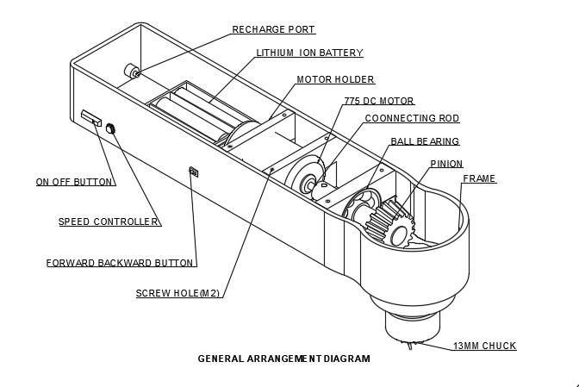
GENERAL ARRANGEMENT DIAGRAM

Slide 9
THANK YOU

